Slide 1
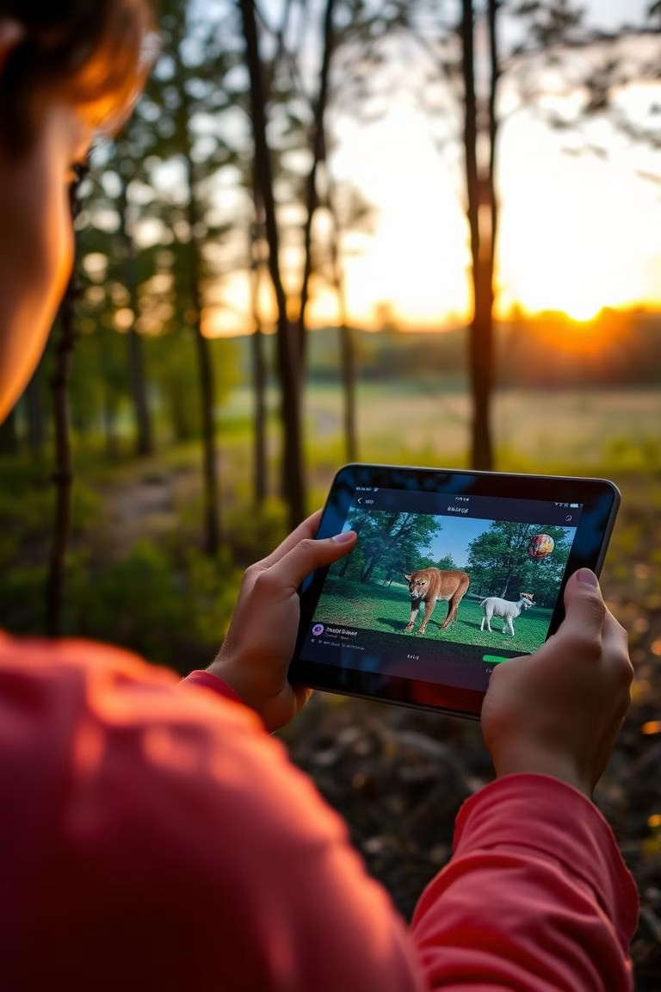
WildSense: Smart Species Detection
WildSense is a machine learning project for animal identification, developed by Roop Narayan and Ayush , using Deep learning techniques to identify animals in images and videos. This presentation will explore the project's workflow, data processing, model training, and real-time detection capabilities.

Slide 2
Introduction
Deep Learning Power
WildSense leverages deep learning to analyze images and identify animal species.
Image and Video Analysis
The system works with both static images and live video feeds, offering versatility for various applications.
Trained Neural Network
A trained neural network acts as the core of the system, analyzing visual features to classify animals.
Tech Stack
Technologies used include TensorFlow, Keras, OpenCV, NumPy, and Python.

Slide 3
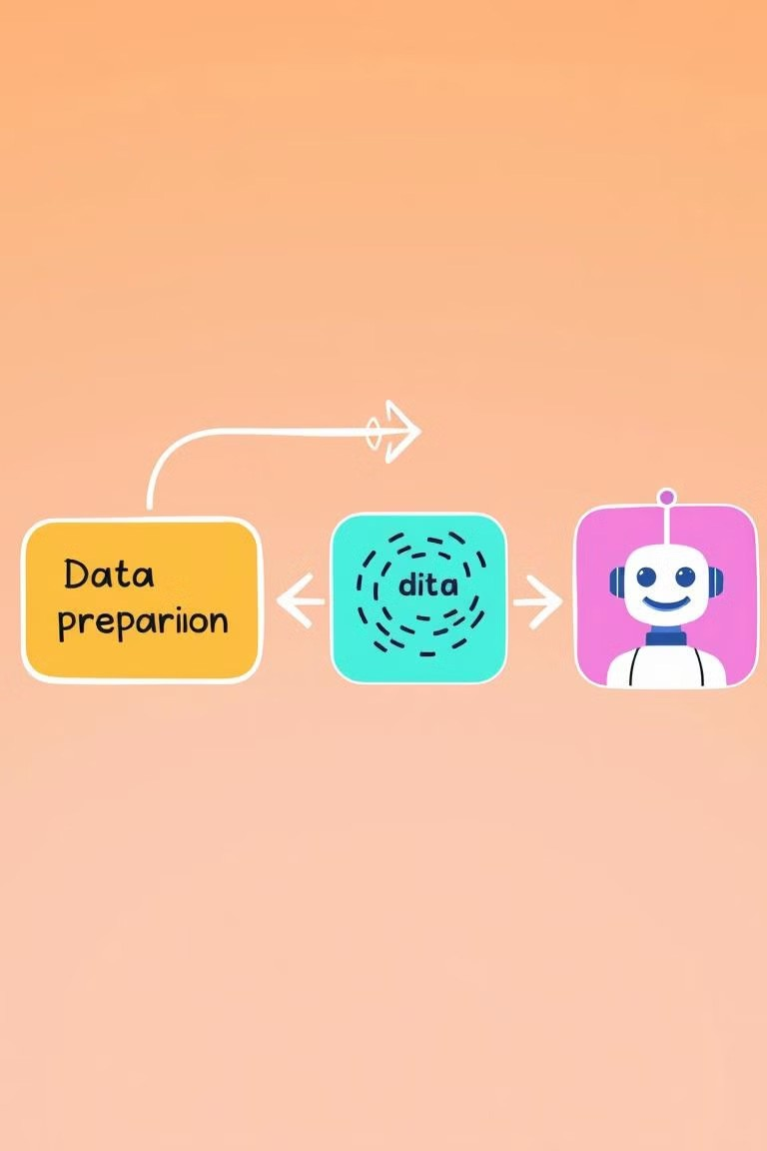



Project Workflow
1
Data Preparation
Start with collecting and augmenting images of different animal species.
2
Model Training
Train the neural network using the prepared dataset to learn animal features.
3
Model Prediction
Use the trained model to predict the species of an animal in a new image or video.

Slide 4
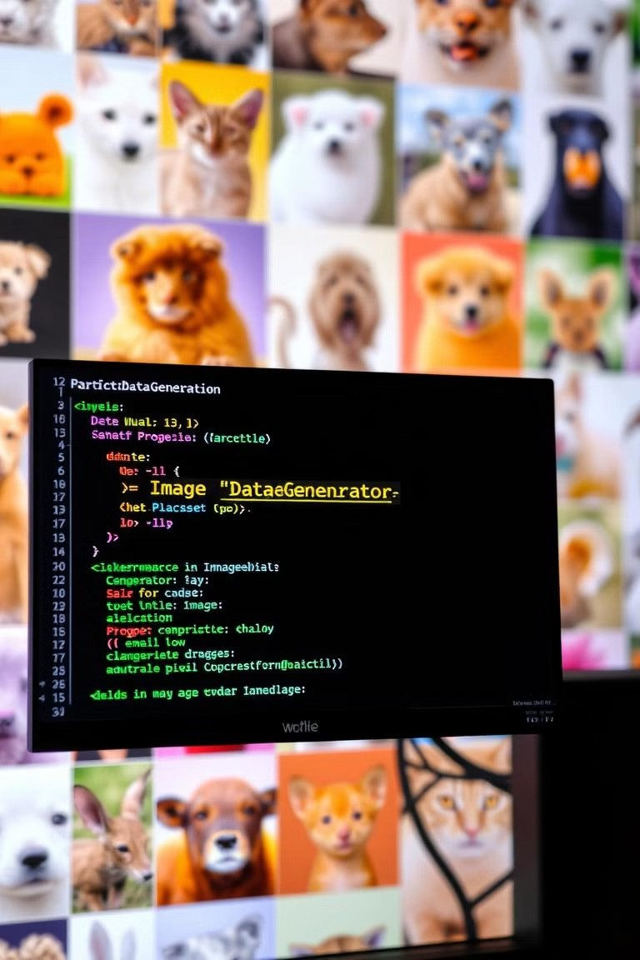
Data Processing
datagen = ImageDataGenerator( rescale=1./255, rotation_range=20, zoom_range=0.2, horizontal_flip=True
)
train_generator = datagen.flow_from_directory(...)

Slide 5




Model Training
Build
Construct the neural network architecture.
1
Train
Feed the training data to the network.
2
Evaluate
Assess the model's performance on a separate dataset.
3
Save
Store the best performing model for later use.
4

Slide 6
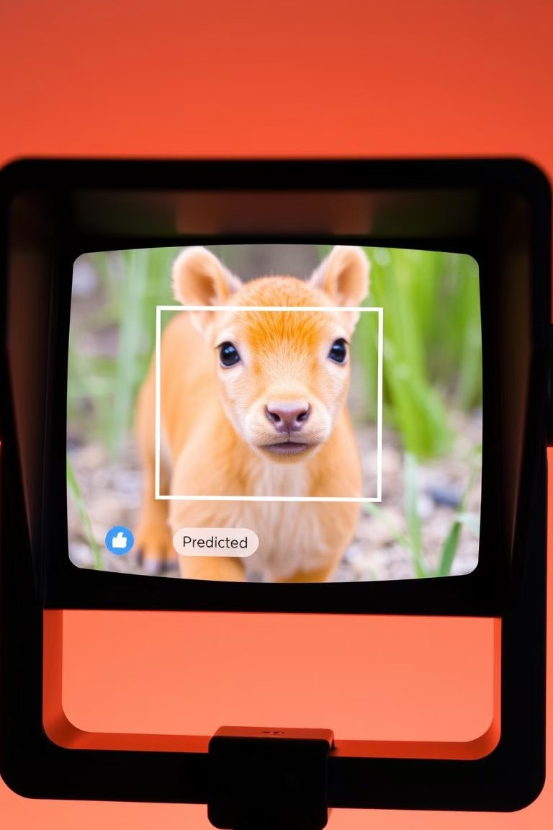
Real-Time Detection
cap = cv2.VideoCapture(0) while True:
ret, frame = cap.read()
img = cv2.resize(frame, (64, 64))
prediction = model.predict(img[np.newaxis, ...])

Slide 7






Technologies Used
Python
The primary programming language used for development.
TensorFlow/Keras
For building and training the deep learning model.
OpenCV
For image and video processing tasks.
NumPy
Provides numerical operations for image manipulation.

Slide 8



Conclusion
1
Animal Species Detection
WildSense successfully detects various animal species using a machine learning model.
2
Wildlife Monitoring
The system can be applied for wildlife monitoring and research purposes.
3
Educational Tool
It serves as an educational tool for learning about different animal species.
4
Future Work
Expand the system's capabilities to identify a wider range of animal species and improve its accuracy.

